Slide 1
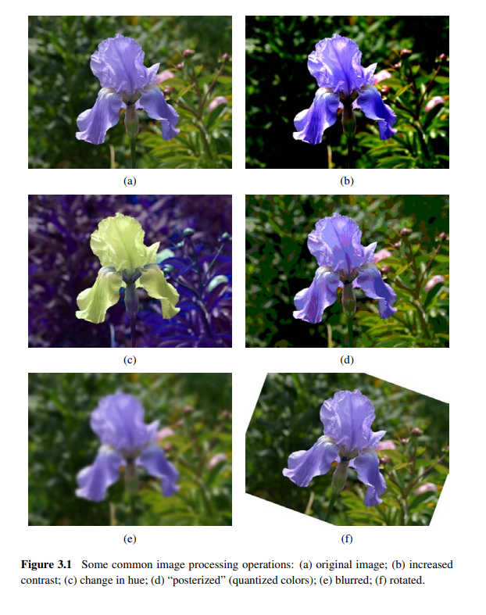
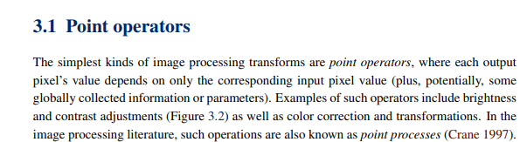
Image processing

Slide 2
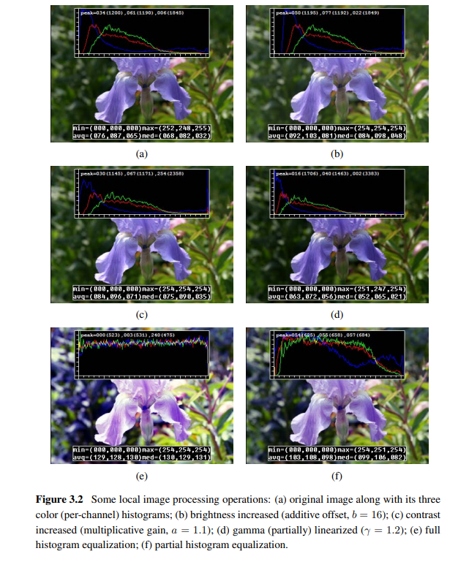
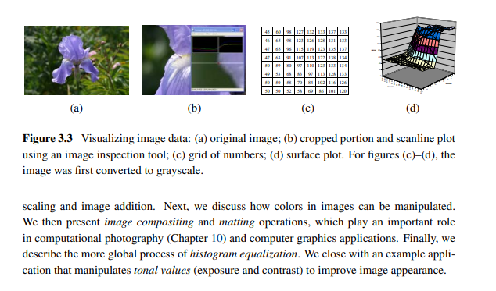

Slide 3
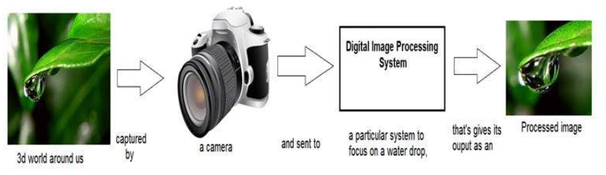
TRANSFORMATION
Transformation is a function.
A function that maps one set to another set after performing some operations.
A system whose input would be an image and output would be an image too. And the system would perform some processing on the input image and gives its output as an processed image. It is shown below.
Now function applied inside this digital system that process an image and convert it into output can be called as transformation function.

Slide 4

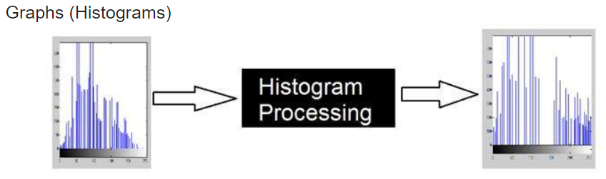
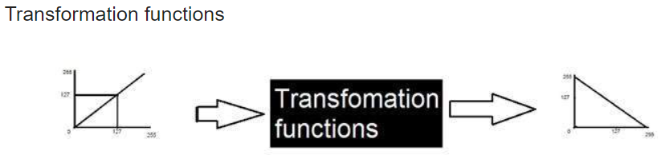
The two different ways of manipulating images were
for increase contrast, image enhancement, brightness e.t.c
Usually the black box(system) used for image processing is an LTI system or linear time invariant system. By linear we mean that such a system where output is always linear , neither log nor exponent or any other. And by time invariant we means that a system which remains same during time.

Slide 5
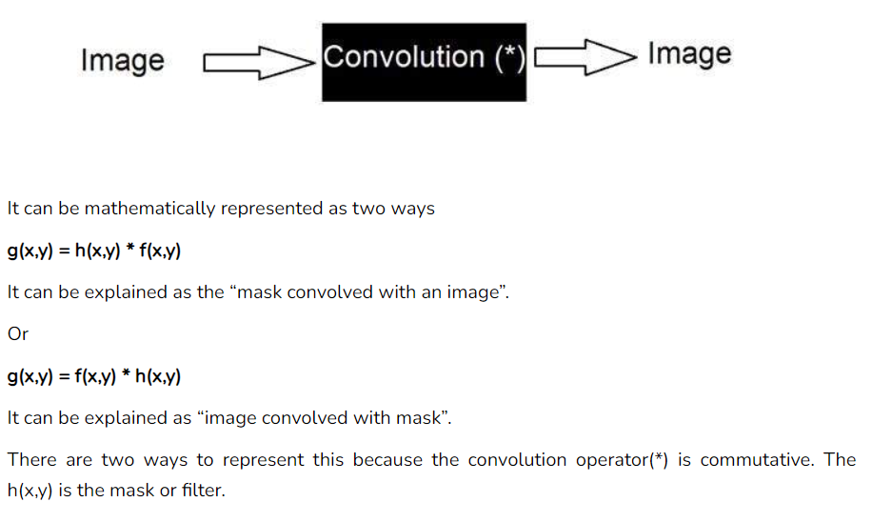
Another way of dealing images-known as convolution.

Slide 6
What is mask?
Mask is also a signal. It can be represented by a two dimensional matrix. The mask is usually of the order of 1x1, 3x3, 5x5, 7x7 .
A mask should always be in odd number, because other wise you cannot find the mid of the mask.
How to perform convolution?
In order to perform convolution on an image, following steps should be taken.
Flip the mask (horizontally and vertically) only once
Slide the mask onto the image.
Multiply the corresponding elements and then add them
Repeat this procedure until all values of the image has been calculated.

Slide 7
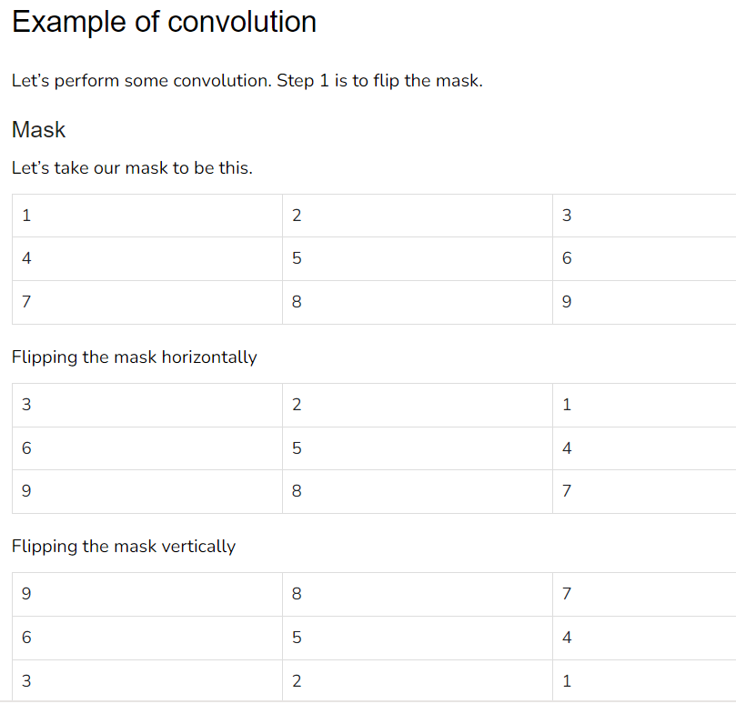

Slide 8
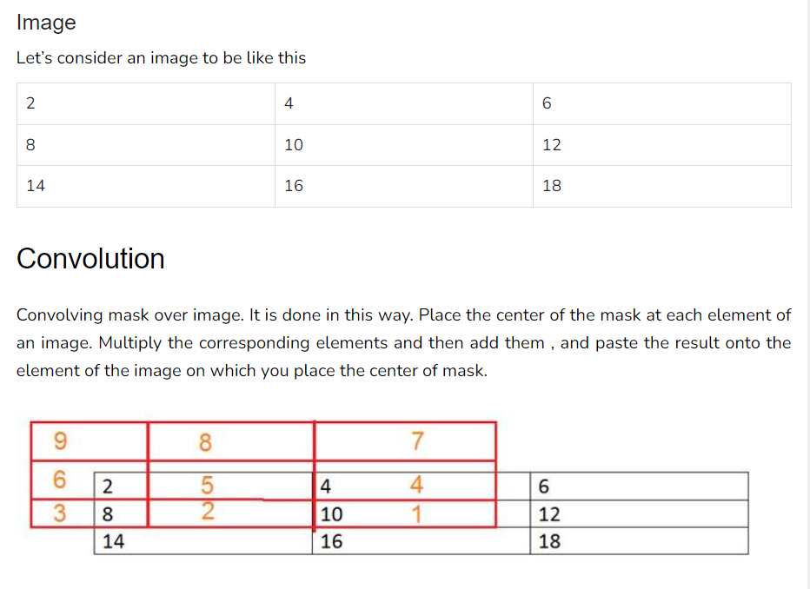

Slide 9
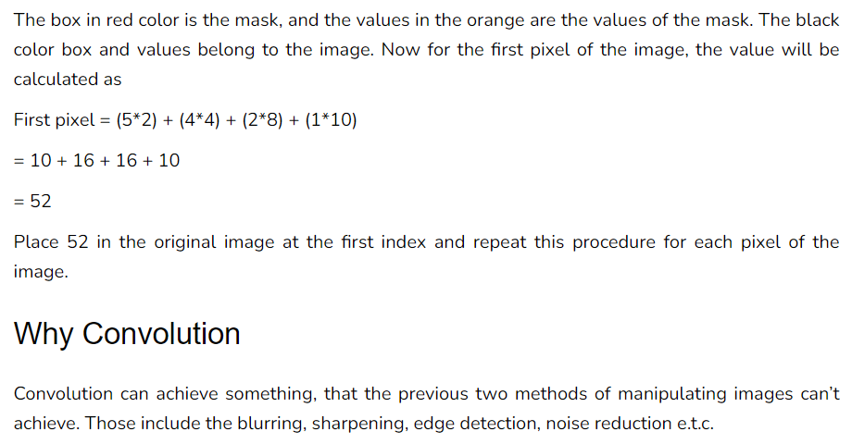

Slide 10
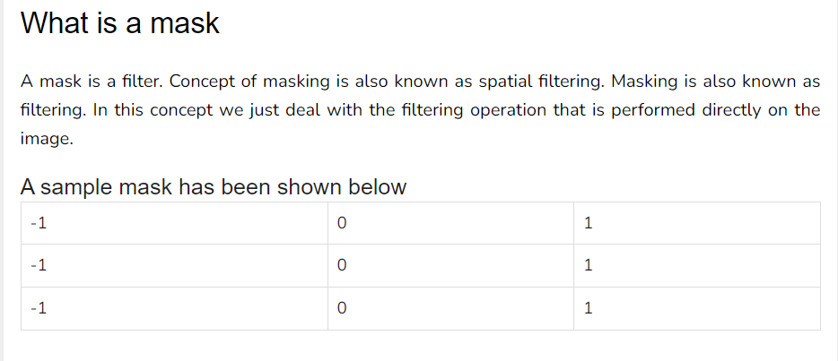

Slide 11
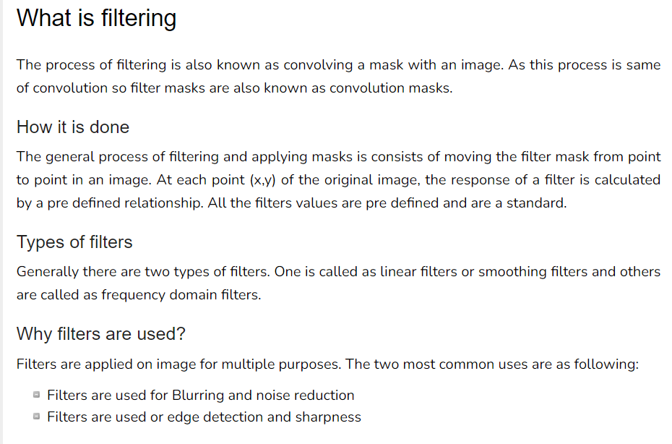

Slide 12
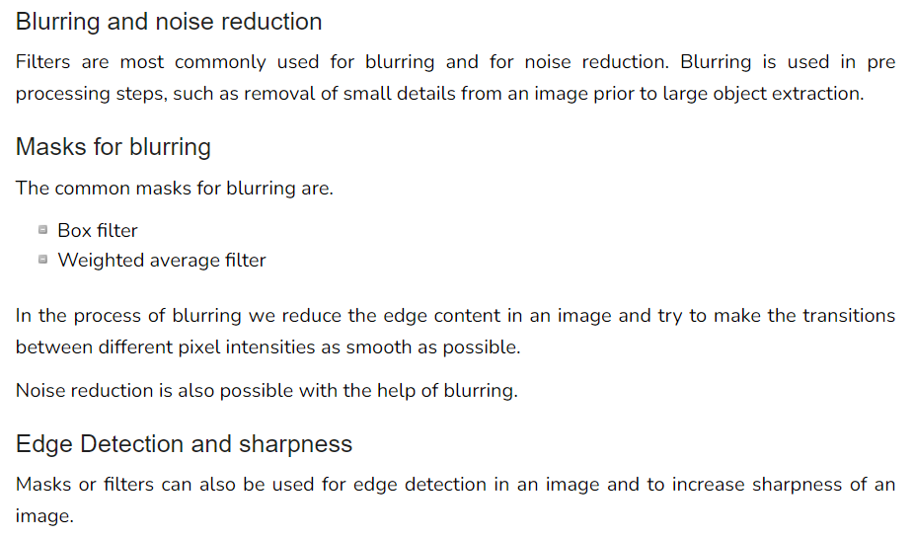

Slide 13
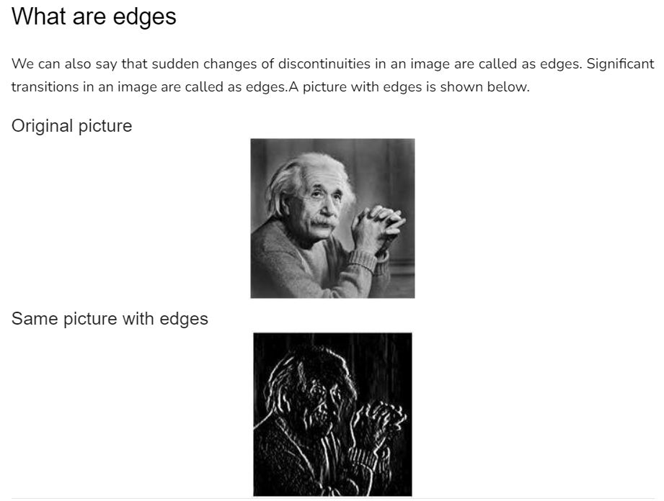

Slide 14
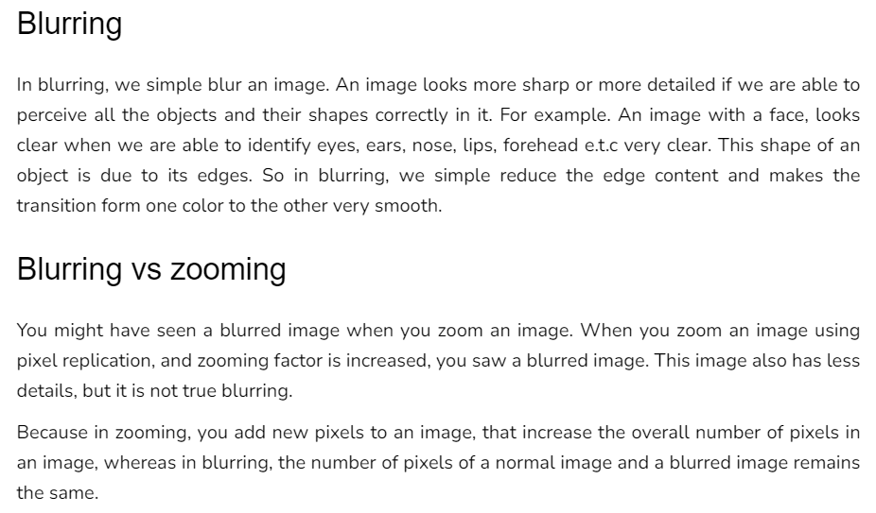

Slide 15
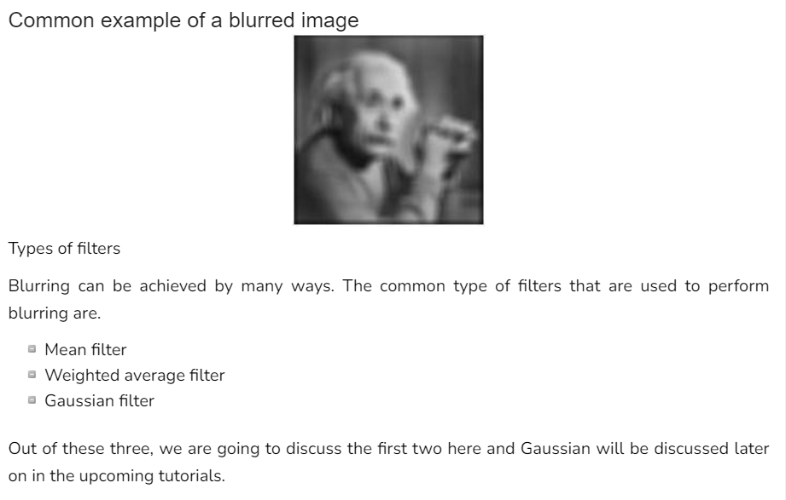

Slide 16
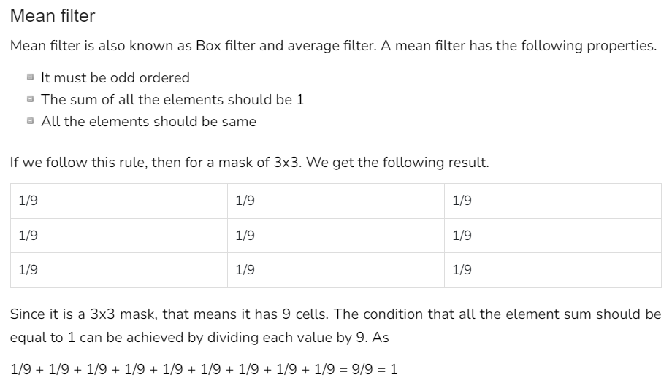

Slide 17
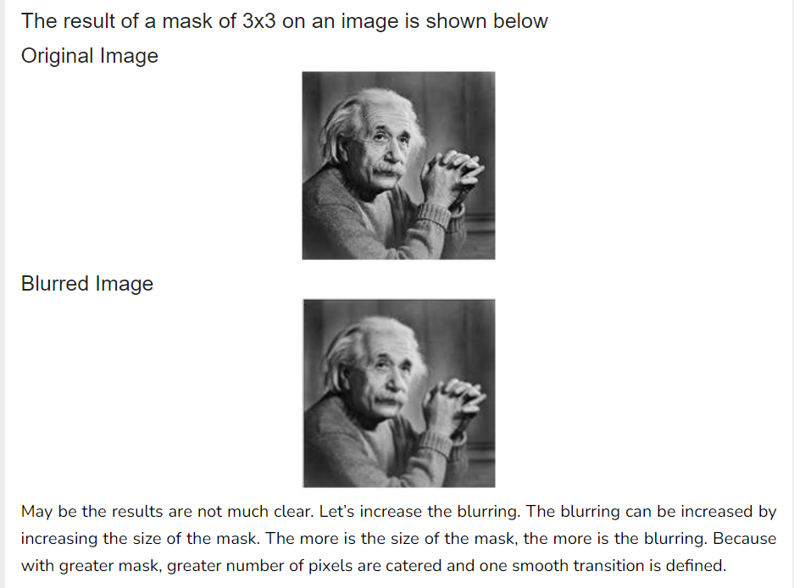

Slide 18
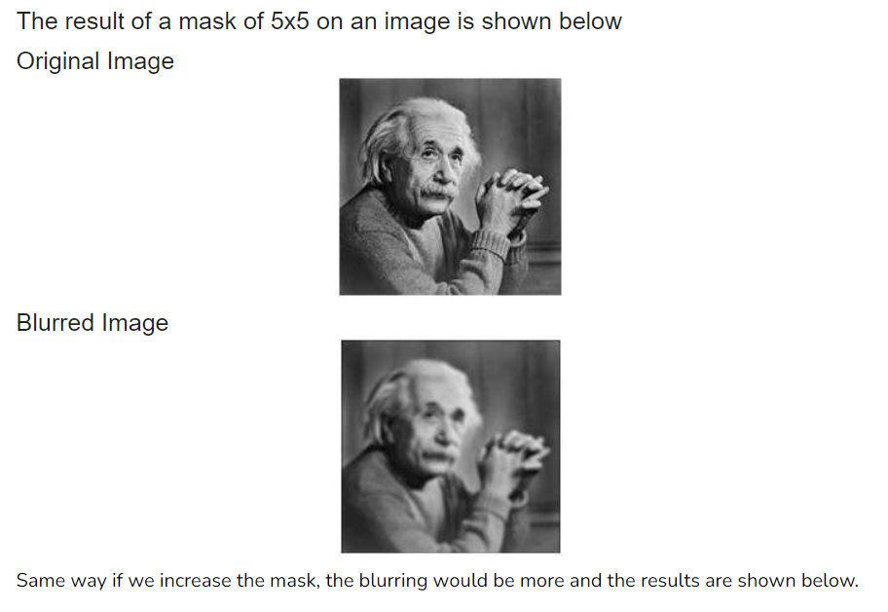

Slide 19
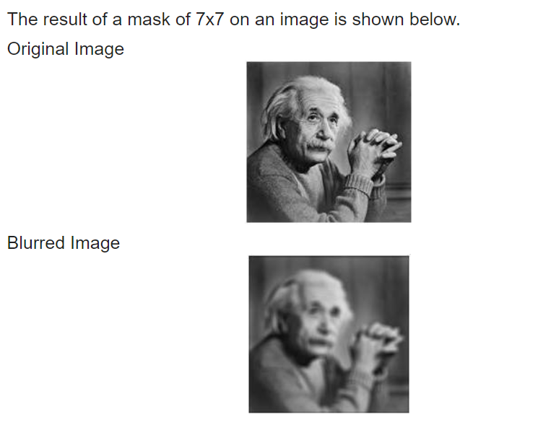
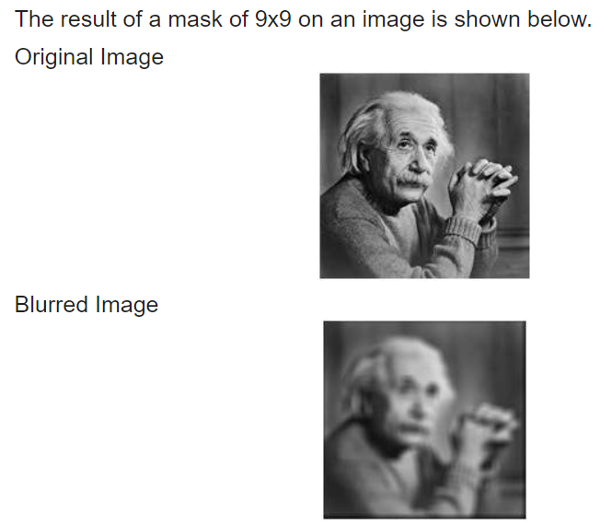

Slide 20
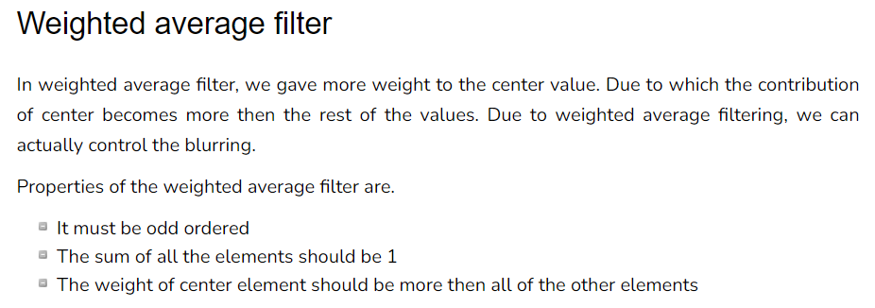
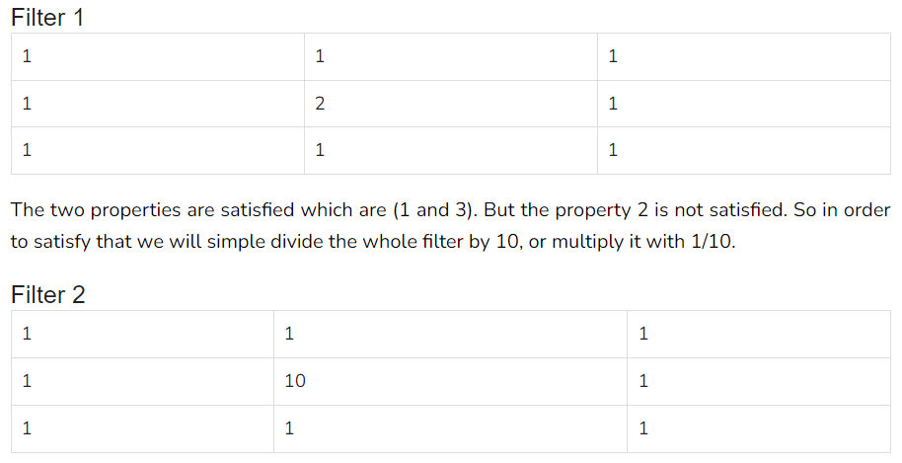

Slide 21
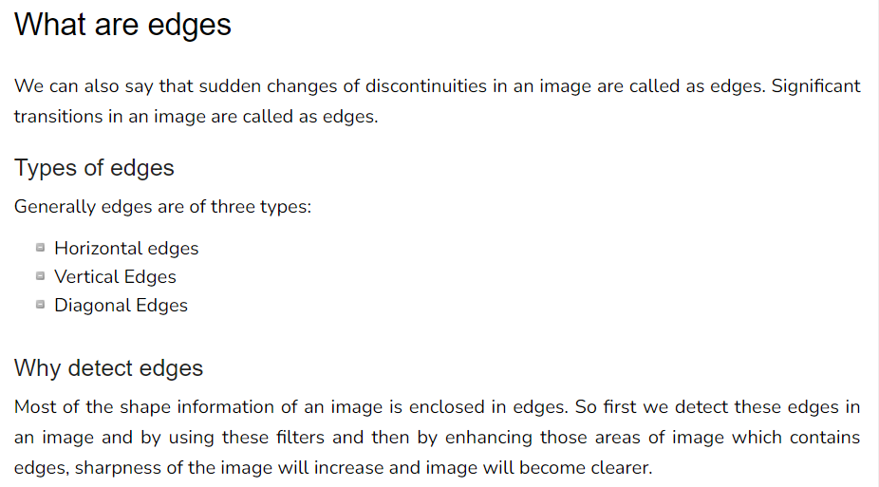

Slide 22
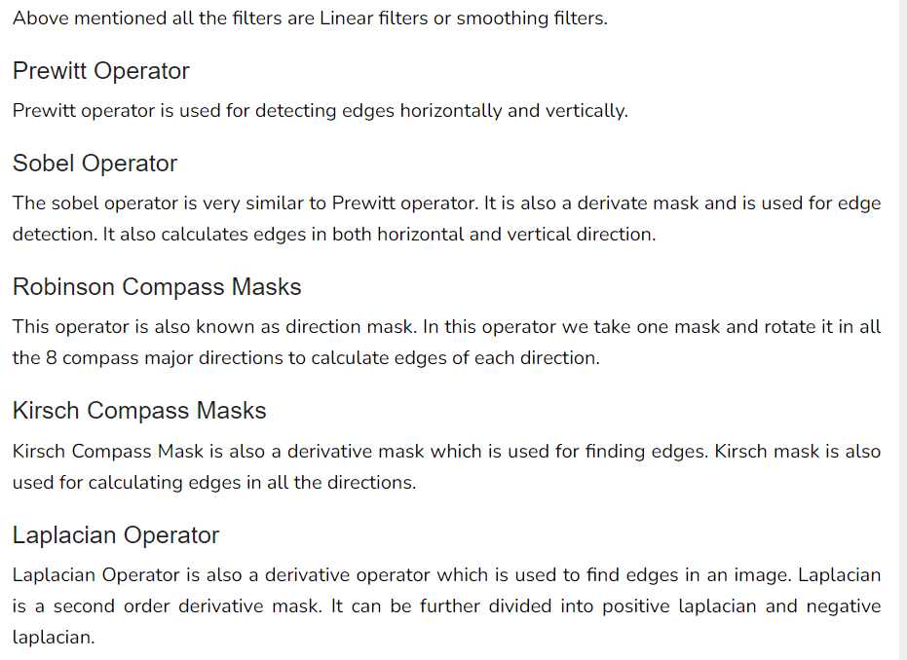

Slide 23
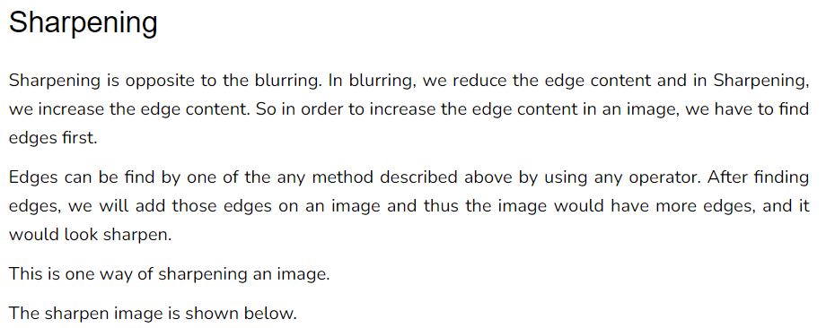
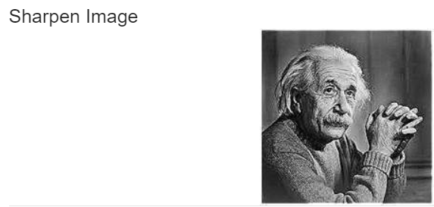


Slide 24
Prewitt operator is used for edge detection in an image.
It detects two types of edges
Horizontal edges
Vertical Edges
Edges are calculated by using difference between corresponding pixel intensities of an image.
All the masks that are used for edge detection are also known as derivative masks.
All the derivative masks should have the following properties:
Opposite sign should be present in the mask.
Sum of mask should be equal to zero.
More weight means more edge detection.

Slide 25
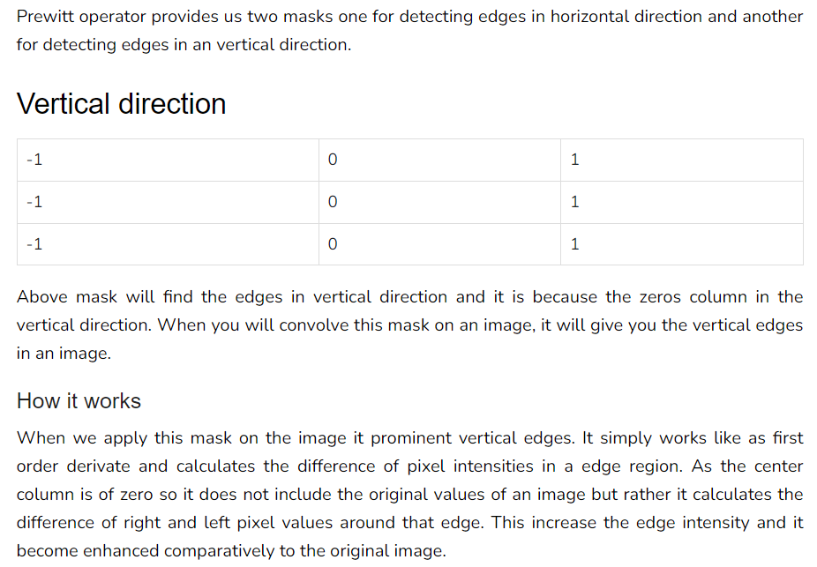

Slide 26
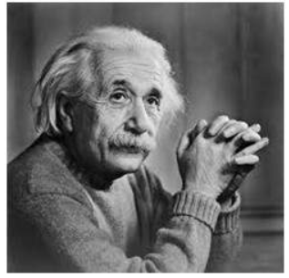
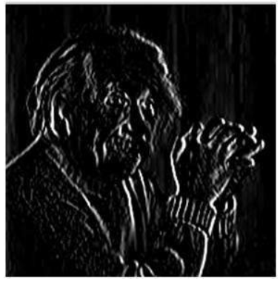
Sample Image
After applying Vertical Mask on the sample image, following image will be obtained. This image contains vertical edges.

Slide 27
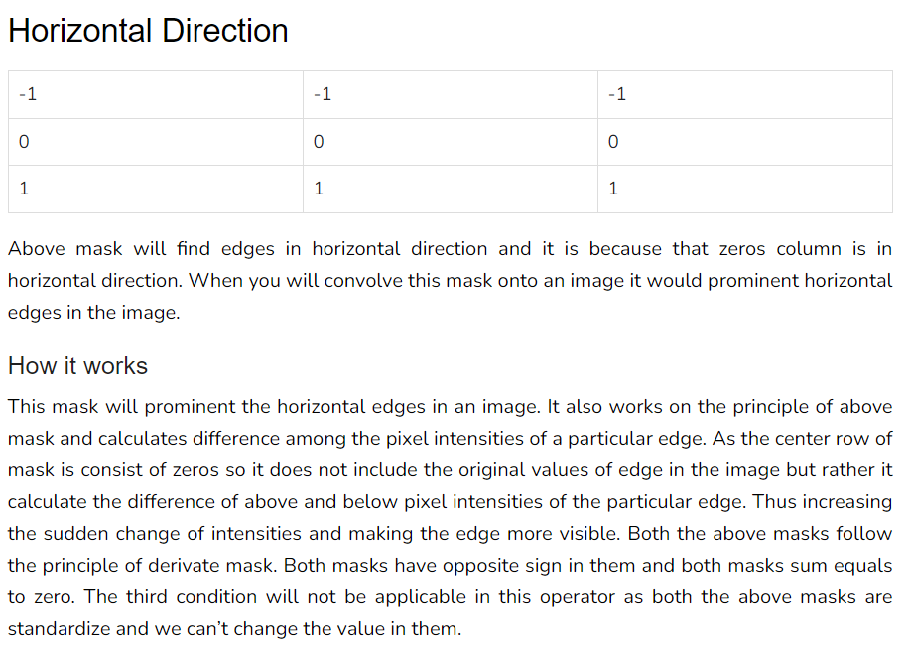

Slide 28
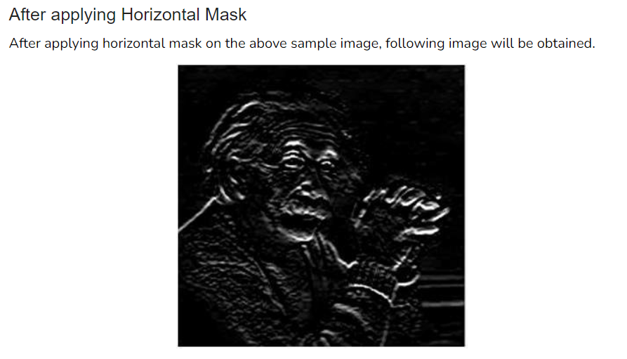
Sample Image

Slide 29
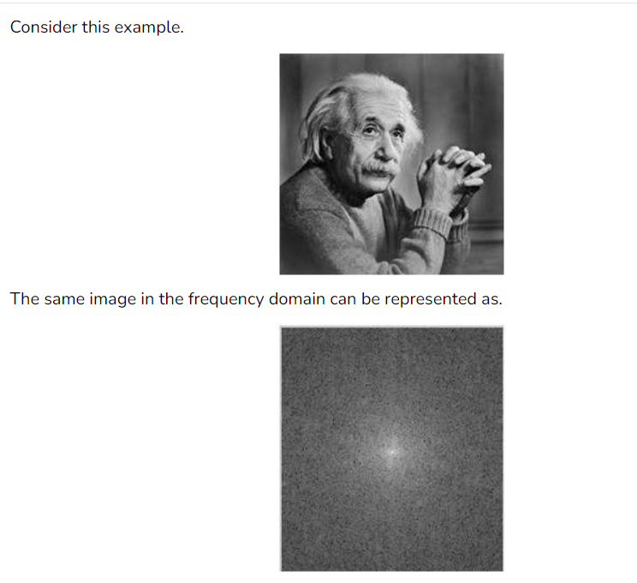
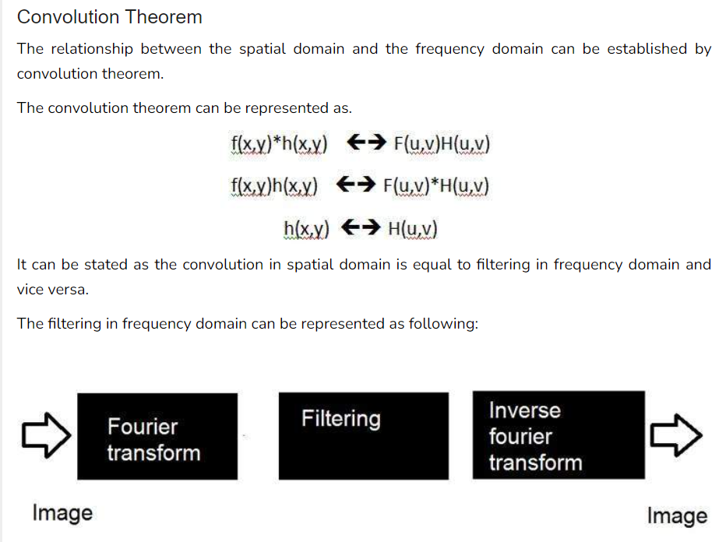
Relationship between frequency domain and the images(spatial domain).

Slide 30
The steps in filtering are given below.
At first step we have to do some pre – processing an image in spatial domain, means increase its contrast or brightness
Then we will take discrete Fourier transform of the image
Then we will center the discrete Fourier transform, as we will bring the discrete Fourier transform in center from corners
Then we will apply filtering, means we will multiply the Fourier transform by a filter function
Then we will again shift the DFT from center to the corners
Last step would be take to inverse discrete Fourier transform, to bring the result back from frequency domain to spatial domain
And this step of post processing is optional, just like pre processing , in which we just increase the appearance of image.

Slide 31
Filters
The concept of filter in frequency domain is same as the concept of a mask in convolution.
After converting an image to frequency domain, some filters are applied in filtering process to perform different kind of processing on an image.
The processing include blurring an image, sharpening an image e.t.c.
The common type of filters for these purposes are:
Ideal high pass filter
Ideal low pass filter
Gaussian high pass filter
Gaussian low pass filter

Slide 32
What are color spaces?
Color spaces are different types of color modes, used in image processing and signals and system for various purposes.
Some of the common color spaces are:
RGB
CMY’K
Y’UV
YIQ
Y’CbCr
HSV

Slide 33
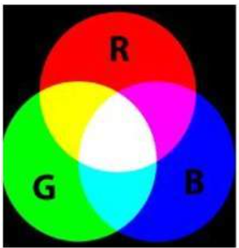
RGB
RGB is the most widely used color space, RGB stands for red green and blue.
What RGB model states, that each color image is actually formed of three different images.
Red image, Blue image, and black image.
A normal grayscale image can be defined by only one matrix, but a color image is actually composed of three different matrices.
One color image matrix = red matrix + blue matrix + green matrix

Slide 34
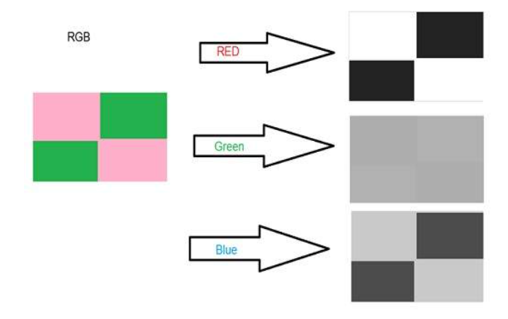

Slide 35
Applications of RGB
Cathode ray tube (CRT)
Liquid crystal display (LCD)
Plasma Display or LED display such as a television
A compute monitor or a large scale screen

Slide 36
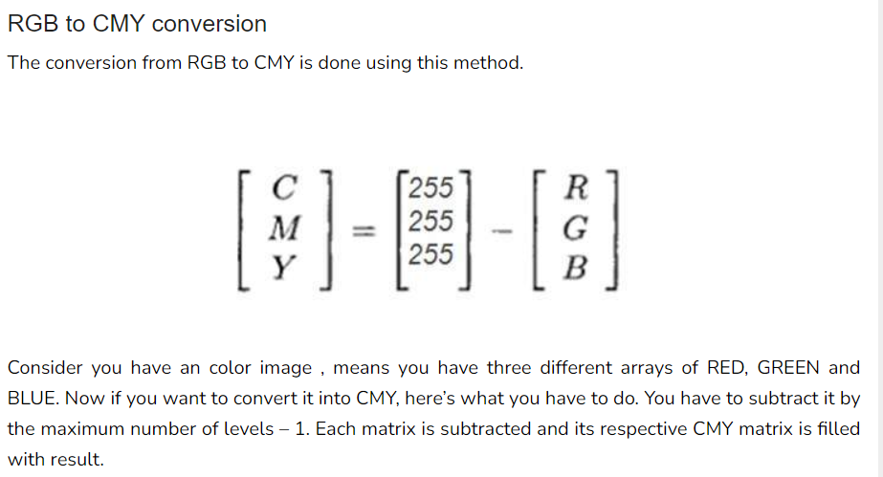

CMYK

Slide 37
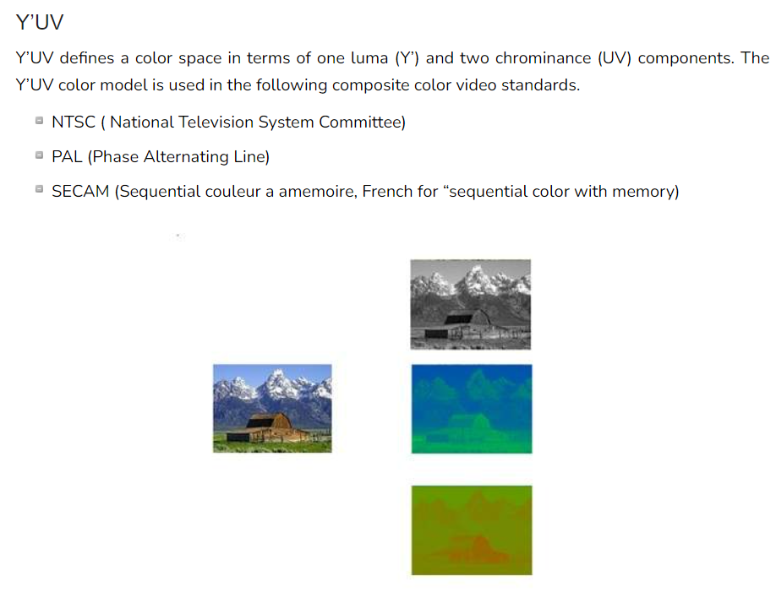

Slide 38
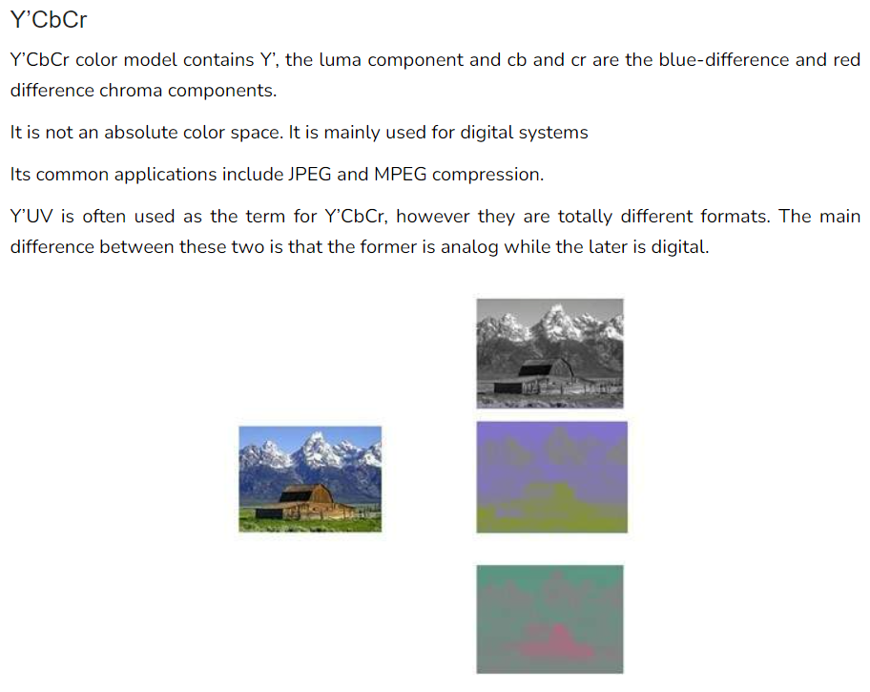

Slide 39
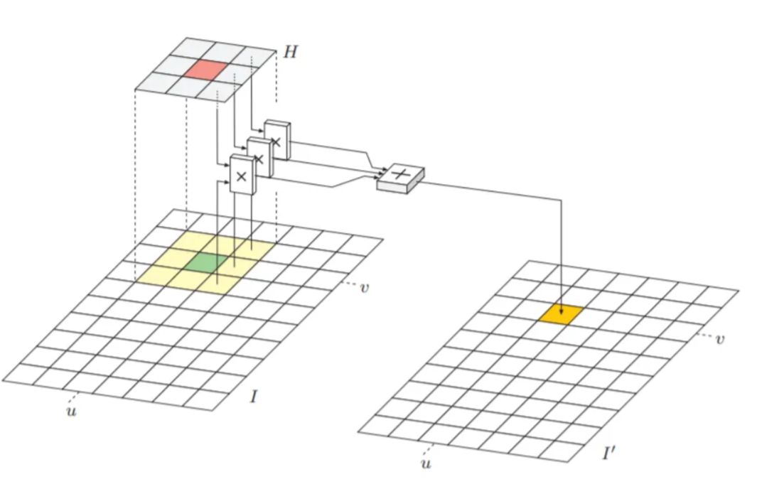
Linear filter
Linear filter is a filter which operate the pixel value in the support region in linear manner (i.e.,as weighted summation).
The support region is specified by the ‘filter matrix’ and be represent as H(i,j).
The size of H is call ‘filter region’ and filter matrix has its own coordinate system, i is column index and j is row index.
The center of it is the origin location and it is called the ‘hot spot’.
Applying weight median filter to the image I, a hotspot location is at the orange shade (center of the filter matrix H)

Slide 40
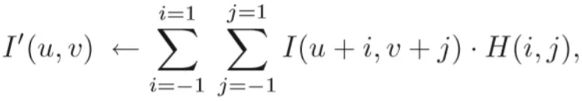
Applying the filter
To apply the filter to the image, please follow these step.
Move the filter matrix over the image I and H(0,0) must go along with the current image position (u,v)
Multiply each filter coefficient H(i,j) with the corresponding image element I(u+i,v+j)
Average all result from the previous step and it is the result for the current location I(u,v)
All steps can be described as equation below

Slide 41
Type of linear filter
Smoothing Filter (This filter has only positive integer.)
Box filter. All members of this filter are the same.
Gaussian filter. The weight of filter member depend on the location of the member. The center of the filter receive the maximum weigh and it decreases with distance from the center.
2. Different Filter
Laplace or Mexican hat filter. Some members of this filter are negative filter and it can calculate by summation of positive member and negative member.

Slide 42
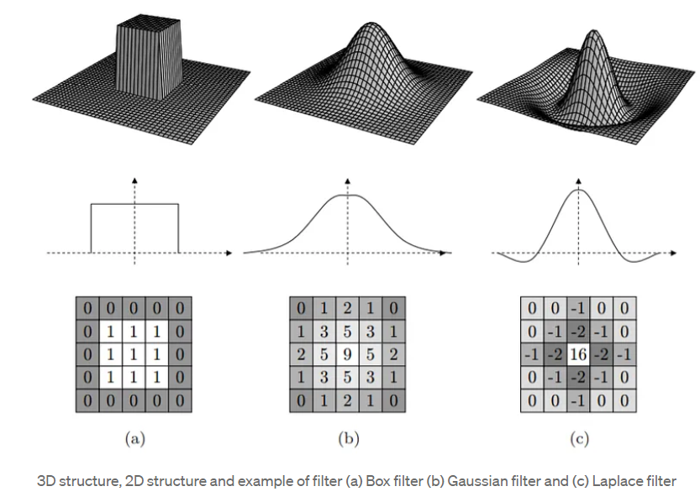

Slide 43
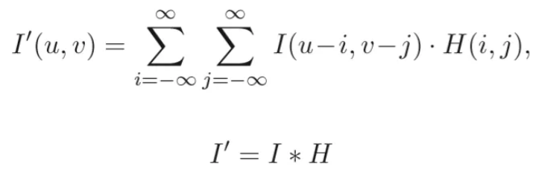
Properties of Linear Filter
First, i will introduce an operation which associate with linear filter. This operation is call “Linear Convolution”.
For two-dimensional function I and H, the convolution operation is defined as the equation
where * is the convolution operation.
Look at the equation you will see that this operation provide the similar result with the linear filter with the filter function which reflect in both horizontal and vertical axis. The convolution matrix H can be called kernel.

Slide 44
Properties of Linear Convolution
Commutativity
Linearity
Associativity
Seperability: the kernel H can be represented as the convolution of multiple kernels and can separated in a pair dimensional kernel x and y.

Slide 45
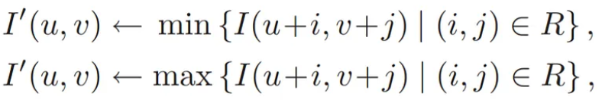
Non-Linear Filters
Noise removing with smoothing filter (a linear filter) provide the result in burred of the image structure, line and edge. Non-Linear Filters were used to solve this problem and it works in non-linear manner.
Type of non-linear filters
Minimum and Maximum Filters: The minimum and maximum value in the moving region R of the original image is the result of the minimum and maximum filter respectively. These filter were defined as
The equation of minimum and maximum filter

Slide 46
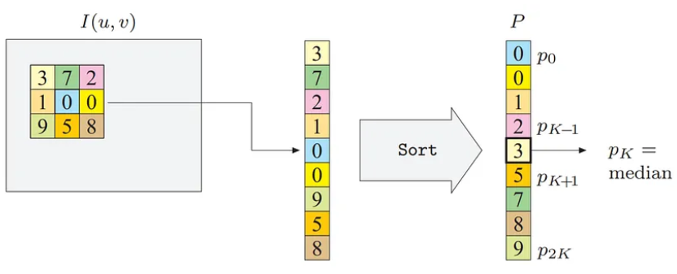
Median Filter: The result was calculated in the same way as the minimum and maximum filter.
The median of all value in moving region R is the result of the median filter.
And this filter typically use for remove salt and pepper noise in the image. This filter was defined as
The figure below show how the median filter work

Slide 47
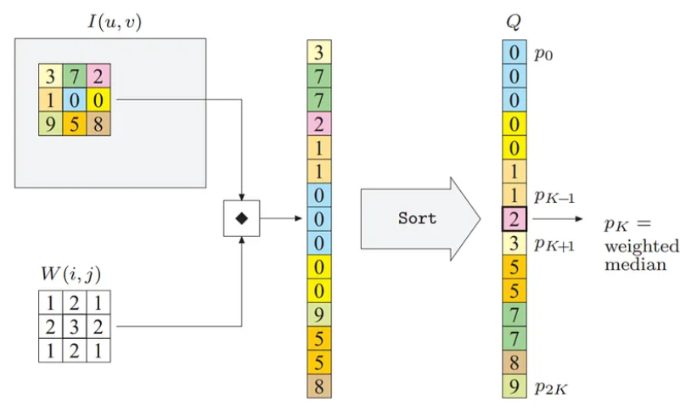
Weight Median Filter: This similar to the median filter, The word “Weight” means extension of each member in the kernel according to weight matrix W.
The position of the filter member near hot spot will obtain the higher weight than others.

Slide 48
What is Morphology?
Morphology is a broad set of image processing operations that process images based on shapes.
Morphological operations apply a structuring element to an input image, creating an output image of the same size.
In a morphological operation, the value of each pixel in the output image is based on a comparison of the corresponding pixel in the input image with its neighbors.

Slide 49
By choosing the size and shape of the neighborhood, we can construct a morphological operation that is sensitive to specific shapes in the input image.
Morphological Processing
They are useful for extracting image components that are useful in representing and describing region shapes
Morphological Operations
Opening and Closing
Dilation and erosion
Gradient

Slide 50
Types of Morphological operations:
Dilation: Dilation adds pixels on the object boundaries.
Erosion: Erosion removes pixels on object boundaries.
Open: The opening operation erodes an image and then dilates the eroded image, using the same structuring element for both operations.
Close: The closing operation dilates an image and then erodes the dilated image, using the same structuring element for both operations.

Slide 51
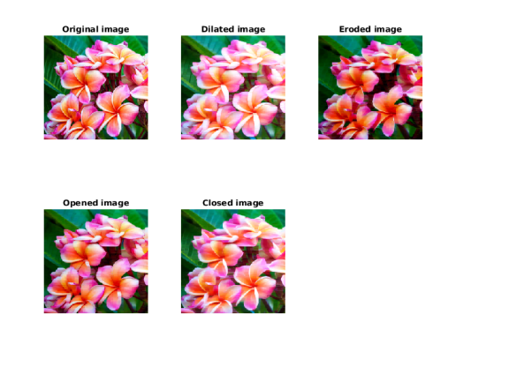

Slide 52
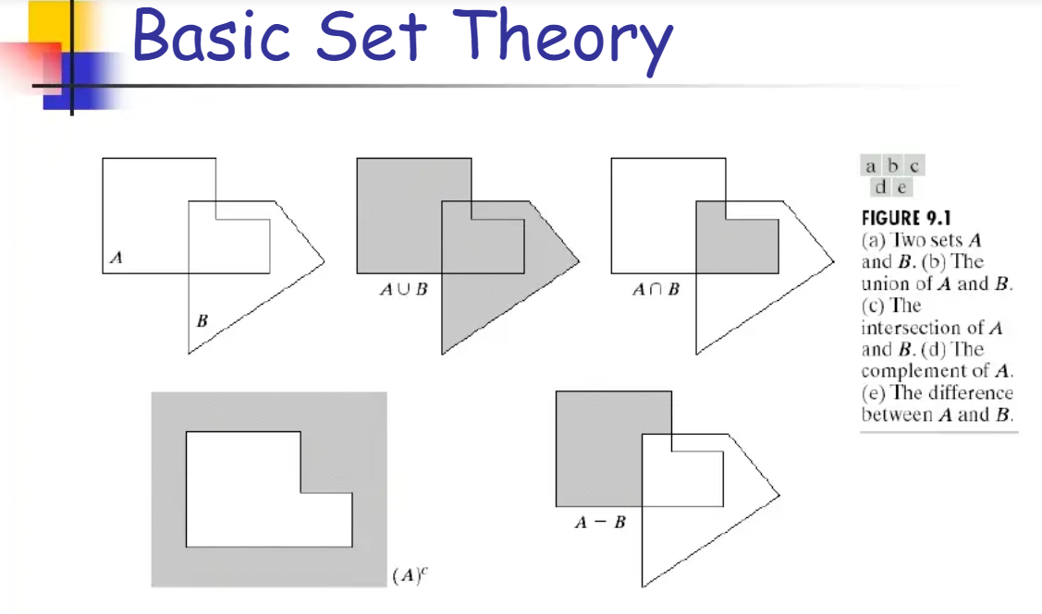

Slide 53
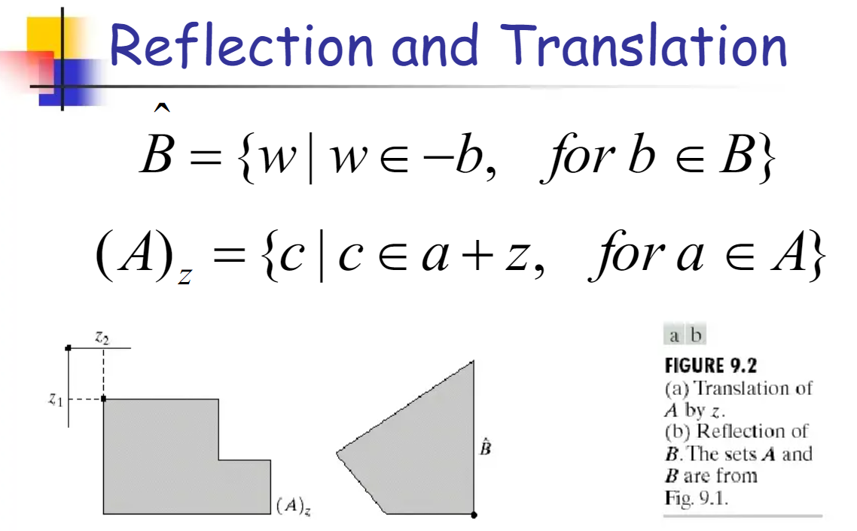

Slide 54


Slide 55


Slide 56


Slide 57


Slide 58


Slide 59


Slide 60





Slide 61


Slide 62

Dilation

Slide 63


Slide 64


Slide 65


Slide 66


Slide 67


Slide 68


Slide 69


Distance Transform
The distance transform is an operator normally only applied to binary images.
The result of the transform is a graylevel image that looks similar to the input image, except that the graylevel intensities of points inside foreground regions are changed to show the distance to the closest boundary from each point.

Slide 70
Connected Component
Once region boundaries have been detected, it is often useful to extract regions which are not separated by a boundary.
Any set of pixels which is not separated by a boundary is call connected.
Each maximal region of connected pixels is called a connected component.
The set of connected components partition an image into segments.
Image segmentation is an useful operation in many image processing applications.
Connected components labeling scans an image and groups its pixels into components based on pixel connectivity, i.e. all pixels in a connected component share similar pixel intensity values and are in some way connected with each other.
Once all groups have been determined, each pixel is labeled with a graylevel or a color (color labeling) according to the component it was assigned to.

Slide 71


Slide 72


Slide 73
Fourier
Fourier was a mathematician in 1822. He give Fourier series and Fourier transform to convert a signal into frequency domain.
Fourier Series
Fourier series simply states that , periodic signals can be represented into sum of sines and cosines when multiplied with a certain weight.
It further states that periodic signals can be broken down into further signals with the following properties.
The signals are sines and cosines
The signals are harmonics of each other

Slide 74


Slide 75

The rate at which something occurs over a particular period of time or in a given sample.
In simple spatial domain, we directly deal with the image matrix.

Slide 76


Slide 77


Slide 78


Slide 79


Slide 80
Each pixel intensity is represented as I(x,y) where x,y is the co-ordinate of the pixel in the 2D matrix. Different operations are carried out in this value.
For example- operation T(say, addition of 5 to all the pixel) is carried out in I(x,y) which means that each pixel value is increased by 5.
This can be written as-
I’(x,y) = T[I(x,y)]
where, I’(x,y) is the new intensity after adding 5 to I(x,y).

Slide 81

Frequency Domain-
In frequency-domain methods are based on Fourier Transform of an image. Roughly, the term frequency in an image tells about the rate of change of pixel values.
Below diagram depicts the conversion of image from spatial domain to frequency domain using Fourier Transformation-

Slide 82
The Fourier Transform is an important image processing tool which is used to decompose an image into its sine and cosine components.
The output of the transformation represents the image in the Fourier or frequency domain, while the input image is the spatial domain equivalent.
In the Fourier domain image, each point represents a particular frequency contained in the spatial domain image.
The Fourier Transform is used in a wide range of applications, such as image analysis, image filtering, image reconstruction and image compression.

Slide 83

How It Works
The DFT is the sampled Fourier Transform and therefore does not contain all frequencies forming an image, but only a set of samples which is large enough to fully describe the spatial domain image.
The number of frequencies corresponds to the number of pixels in the spatial domain image, i.e. the image in the spatial and Fourier domain are of the same size.
For a square image of size N×N, the two-dimensional DFT is given by:
where f(a,b) is the image in the spatial domain and the exponential term is the basis function corresponding to each point F(k,l) in the Fourier space.
The equation can be interpreted as: the value of each point F(k,l) is obtained by multiplying the spatial image with the corresponding base function and summing the result.

Slide 84

The basis functions are sine and cosine waves with increasing frequencies, i.e. F(0,0) represents the DC-component of the image which corresponds to the average brightness and F(N-1,N-1) represents the highest frequency.
In a similar way, the Fourier image can be re-transformed to the spatial domain.
The inverse Fourier transform is given by:
Note the normalization term in the inverse transformation.
This normalization is sometimes applied to the forward transform instead of the inverse transform, but it should not be used for both

Slide 85


To obtain the result for the above equations, a double sum has to be calculated for each image point.
However, because the Fourier Transform is separable, it can be written as
where
Using these two formulas, the spatial domain image is first transformed into an intermediate image using N one-dimensional Fourier Transforms.
This intermediate image is then transformed into the final image, again using N one-dimensional Fourier Transforms.
Expressing the two-dimensional Fourier Transform in terms of a series of 2N one-dimensional transforms decreases the number of required computations.

Slide 86
The Fourier Transform produces a complex number valued output image which can be displayed with two images, either with the real and imaginary part or with magnitude and phase.
In image processing, often only the magnitude of the Fourier Transform is displayed, as it contains most of the information of the geometric structure of the spatial domain image.
However, if we want to re-transform the Fourier image into the correct spatial domain after some processing in the frequency domain, we must make sure to preserve both magnitude and phase of the Fourier image.
The Fourier domain image has a much greater range than the image in the spatial domain.
Hence, to be sufficiently accurate, its values are usually calculated and stored in float values.

Slide 87

The Fourier Transform is used if we want to access the geometric characteristics of a spatial domain image.
Because the image in the Fourier domain is decomposed into its sinusoidal components, it is easy to examine or process certain frequencies of the image, thus influencing the geometric structure in the spatial domain.
In most implementations the Fourier image is shifted in such a way that the DC-value (i.e. the image mean) F(0,0) is displayed in the center of the image.
The further away from the center an image point is, the higher is its corresponding frequency.
We start off by applying the Fourier Transform of

Slide 88


The magnitude calculated from the complex result is shown in
However, the dynamic range of the Fourier coefficients (i.e. the intensity values in the Fourier image) is too large to be displayed on the screen, therefore all other values appear as black.
If we apply a logarithmic transformation to the image we obtain

Slide 89

The result shows that the image contains components of all frequencies, but that their magnitude gets smaller for higher frequencies.
Hence, low frequencies contain more image information than the higher ones. The transform image also tells us that there are two dominating directions in the Fourier image, one passing vertically and one horizontally through the center.
These originate from the regular patterns in the background of the original image.
The phase of the Fourier transform of the same image is shown in

Slide 90

The value of each point determines the phase of the corresponding frequency. As in the magnitude image, we can identify the vertical and horizontal lines corresponding to the patterns in the original image.
The phase image does not yield much new information about the structure of the spatial domain image; therefore, in the following examples, we will restrict ourselves to displaying only the magnitude of the Fourier Transform.
Before we leave the phase image entirely, however, note that if we apply the inverse Fourier Transform to the above magnitude image while ignoring the phase (and then histogram equalize the output) we obtain

Slide 91
Fourier transform
The Fourier transform simply states that the non periodic signals whose area under the curve is finite can also be represented into integrals of the sines and cosines after being multiplied by a certain weight.
The Fourier transform has many wide applications that include , image compression (e.g JPEG compression) , filtering and image analysis.
Difference between Fourier series and transform
Although both Fourier series and Fourier transform are given by Fourier , but the difference between them is Fourier series is applied on periodic signals and Fourier transform is applied for non periodic signals

Slide 92


Slide 93



Slide 94


Slide 95



Slide 96

An adaptive filter is a system with a linear filter that has a transfer function controlled by variable parameters and a means to adjust those parameters according to an optimization algorithm.

Slide 97


Defined as a sequence of random variables, where the index of the sequence has the interpretation of time.

Slide 98



Slide 99



Slide 100


Slide 101


Slide 102


Slide 103


Slide 104



Slide 105


Slide 106



Slide 107


Slide 108


Slide 109


Slide 110



Slide 111


Slide 112


Slide 113


Slide 114


Slide 115


Slide 116


Slide 117


Slide 118



Slide 119


Slide 120


Slide 121


Slide 122


Slide 123


Slide 124


Slide 125


Slide 126


Slide 127


Slide 128
Image transformation
Consider this equation
G(x,y) = T{ f(x,y) }
In this equation,
f(x,y) = input image on which transformation function has to be applied.
G(x,y) = the output image or processed image.
T is the transformation function.
This relation between input image and the processed output image can also be represented as s = T (r)
where r is actually the pixel value or gray level intensity of f(x,y) at any point.
and s is the pixel value or gray level intensity of g(x,y) at any point.

Slide 129


Examples
Consider this transformation function.
Lets take the point r to be 256, and the point p to be 127. Consider this image to be a one bpp image. That means we have only two levels of intensities that are 0 and 1. So in this case the transformation shown by the graph can be explained as.
All the pixel intensity values that are below 127 (point p) are 0, means black. And all the pixel intensity values that are greater then 127, are 1, that means white. But at the exact point of 127, there is a sudden change in transmission, so we cannot tell that at that exact point, the value would be 0 or 1.
Mathematically this transformation function can be denoted as:

Slide 130

It shows that for each pixel or intensity value of input image, there is a same intensity value of output image.
That means the output image is exact replica of the input image.
It can be mathematically represented as: g(x,y) = f(x,y)
The input and output image would be in this case are shown below.

Slide 131


Slide 132


Slide 133
Suppose we want to change image A to match image B.
For each of the colour channels we want to apply a linear transformation:
V_{out} = V_{A} * gain + bias
where V_{A} is a pixel value in image A, V_{out} is the resulting pixel value, and:
gain = SD_{B} / SD_{A}
bias = mean_{B} - mean_{A} * gain
SD is the standard deviation.
If image B is a flat colour, SD_{B}==0, so gain=0 and bias=mean_{B},
so image A will be made exactly the same colour as image B.
We can use the results, gain and bias, as two arguments to "-function Polynomial".
The inverse is simple:
V_{A} = (V_{out} - bias) / gain V_{A} = V_{out}/gain - bias/gain

Slide 134

Color is a powerful descriptor
Human can discern thousands of color shades.
“Color" is more pleasing than "black and white“.
Full Color: color from full-color sensor, i.e., CCD camera
Pseudo color: assign a color to a particular monochromatic intensity.
Color Spectrum seen by passing white through a prism

Slide 135


Popular color spaces used in digital image processing include RGB, CMYK, HSV, and Lab.
Color transforms in digital image processing can be performed using mathematical operations such as matrix multiplication and color lookup tables.

Slide 136



Slide 137
Compositing and matting
It is often desirable to cut a foreground object out of one scene and put it on top of a different background (Figure 3.4).
The process of extracting the object from the original image is often called matting.
While the process of inserting it into another image (without visible artifacts) is called compositing.
To composite a new (or foreground) image on top of an old (background) image, the over operator, is used, C = (1 − α)B + αF.
This operator attenuates the influence of the background image B by a factor (1 − α) and then adds in the color (and opacity) values corresponding to the foreground layer F

Slide 138


Slide 139



Slide 140

Histogram equalization
Histogram equalization is used to enhance contrast. It is not necessary that contrast will always be increase in this. There may be some cases were histogram equalization can be worse. In that cases the contrast is decreased.
Lets start histogram equalization by taking this image below as a simple image.
Image

Slide 141


Slide 142
The histogram of a digital image, with intensity levels between 0 and (L-1), is a function h( rk ) = nk , where rk is the kth intensity level and nk is the number of pixels in the image having that intensity level.
We can also normalize the histogram by dividing it by the total number of pixels in the image.
For an N x N image, we have the following definition of a normalized histogram function:
p( rk ) = nk/N2
This p(rk) function is the probability of the occurrence of a pixel with the intensity level rk. Clearly,
∑ p( rk ) = 1
The histogram of an image, as shown in the figure, consists of the x-axis representing the intensity levels rk and the y-axis denoting the h(rk) or the p(rk) functions.

Slide 143


Slide 144

Linear filtering
The most commonly used type of neighborhood operator is a linear filter, in which an output pixel’s value is determined as a weighted sum of input pixel values (Figure 3.10), g(i, j) = X k,l f(i + k, j + l)h(k, l). (3.12)
The entries in the weight kernel or mask h(k, l) are often called the filter coefficients.
The above correlation operator can be more compactly notated as g = f ⊗ h. (3.13)
A common variant on this formula is g(i, j) = X k,l f(i − k, j − l)h(k, l) = X k,l f(k, l)h(i − k, j − l),

Slide 145


Slide 146

Examples of linear filtering
The simplest filter to implement is the moving average or box filter, which simply averages the pixel values in a K ×K window. This is equivalent to convolving the image with a kernel of all ones and then scaling (Figure 3.14a).

Slide 147



Slide 148

Band-pass and steerable filters

Slide 149


Slide 150



Slide 151
More neighborhood operators
Neighborhood operators include morphological operators that operate on binary images, as well as semi-global operators that compute distance transforms and find connected components in binary images
Non-linear filtering
The filters we have looked at so far have all been linear, i.e., their response to a sum of two signals is the same as the sum of the individual responses.
This is equivalent to saying that each output pixel is a weighted summation of some number of input pixels (3.19).
Linear filters are easier to compose and are amenable to frequency response analysis. In many cases, however, better performance can be obtained by using a non-linear combination of neighboring pixels.

Slide 152


Slide 153



Slide 154

Median filtering
A better filter to use in this case is the median filter, which selects the median value from each pixel’s neighborhood (Figure 3.19a).
Median values can be computed in expected linear time using a randomized select algorithm (Cormen 2001) and incremental variants have also been developed by Tomasi and Manduchi (1998) and Bovik (2000, Section 3.2).
Since the shot noise value usually lies well outside the true values in the neighborhood, the median filter is able to filter away such bad pixels (Figure 3.18c)
Another possibility is to compute a weighted median, in which each pixel is used a number of times depending on its distance from the center. This turns out to be equivalent to minimizing the weighted objective function

Slide 155
where g(i, j) is the desired output value and p = 1 for the weighted median. The value p = 2 is the usual weighted mean, which is equivalent to correlation (3.12) after normalizing by the sum of the weights
Consider the noisy image in Figure 3.18a. In order to remove most of the noise, the Gaussian filter is forced to smooth away high-frequency detail, which is most noticeable near strong edges.
Median filtering does better but, as mentioned before, does not do as good a job at smoothing away from discontinuities.

Slide 156

Bilateral filtering

Slide 157


Slide 158

Morphology

Slide 159


Slide 160


Slide 161

https://slideplayer.com/slide/7468893/

Slide 162


